Slide 1
Create Azure Services with Terraform
ICT Precedent Development Group
2021.01.15

Slide 2
Azure Services For Prod Env
Below are the list of Azure Services needs to be created.
1). Resource Group
2). Azure Event hub namespace
3). Three Azure Event hub
4). Storage account
5). Three Containers in storage account
6). IOT Hub
7). Azure Kubernetes cluster

Slide 3
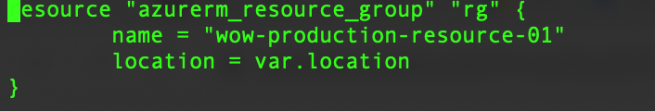
Azure Services For Prod Env
Resource groups
Here we have defined all services in terraform file, still I am showing you in the resource file.

Slide 4
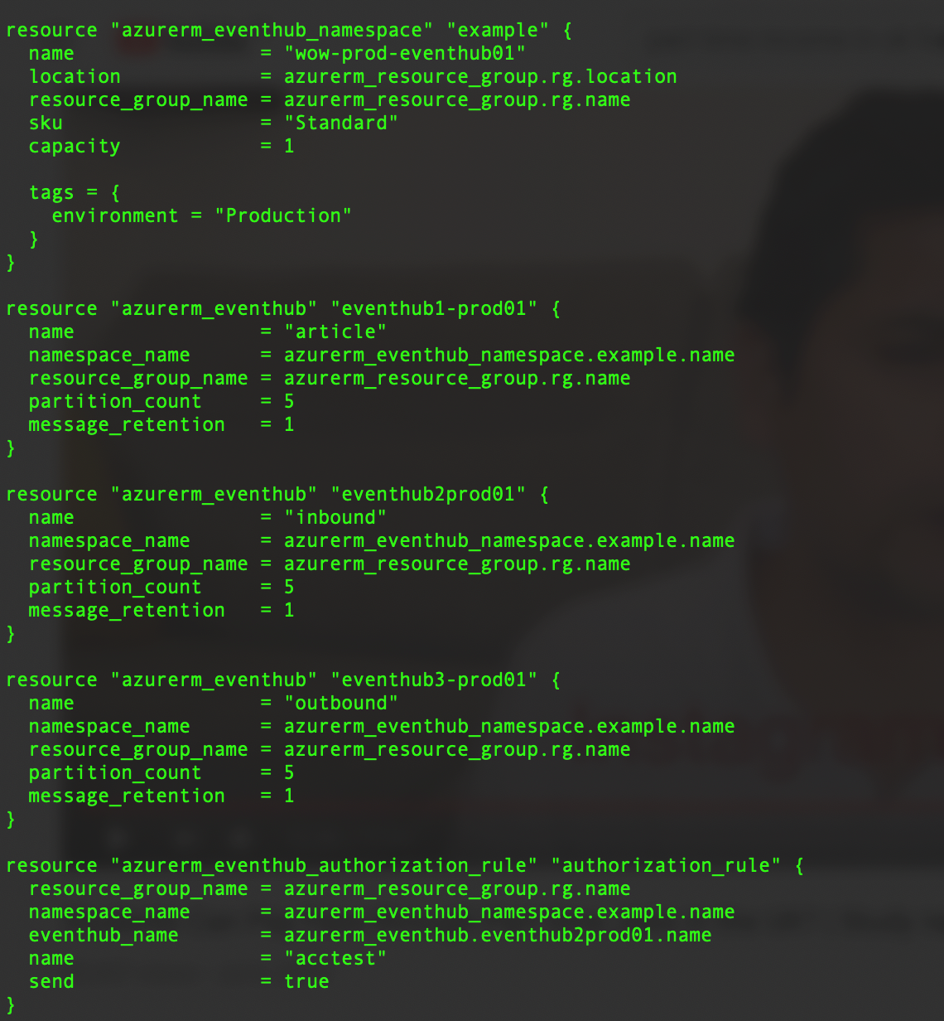
Azure Services For Prod Env
Event Hubs: Here We created name spaces and three event hubs(article, inbound and outbound)

Slide 5
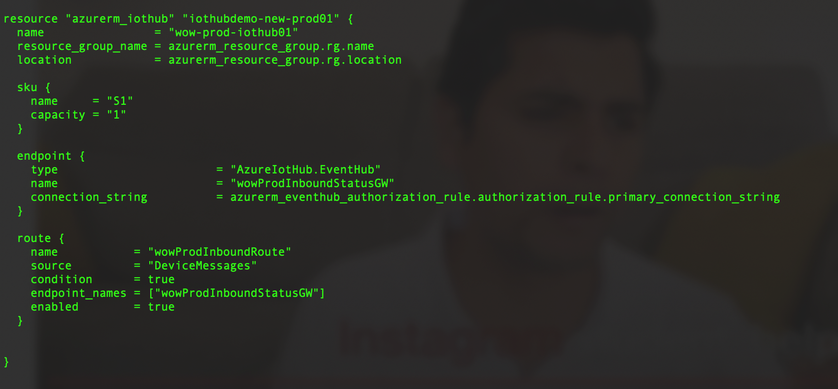
Azure Services For Prod Env
IoT Hub and its message routing too.

Slide 6
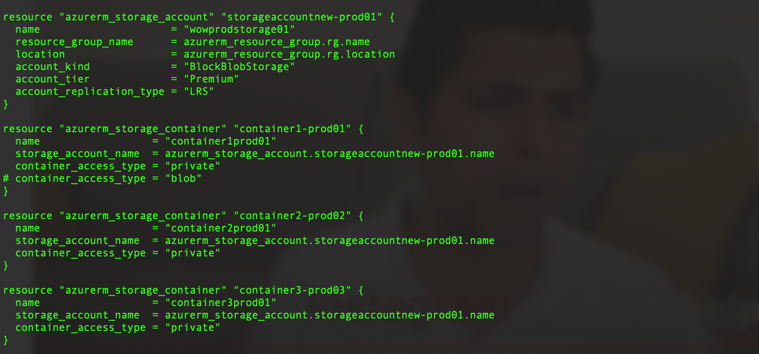
Azure Services For Prod Env
Storage accounts and three containers and their access type should be blob.

Slide 7
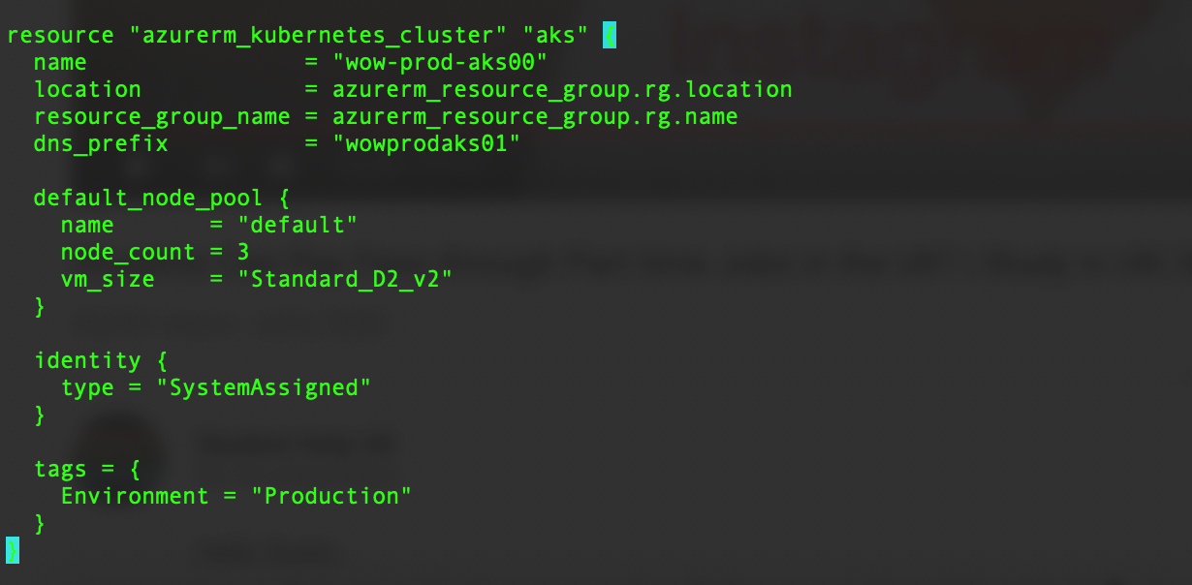
Azure Services For Prod Env
Kubernetes services

Slide 8
How to login into the Azure CLI, and set the subscription
Firstly, login to the Azure CLI using:
# az login
Once logged in - it's possible to list the Subscriptions associated with the account via:
# az account list
The output (similar to below) will display one or more Subscriptions - with the id field being the subscription_id field referenced above.
[
{
"cloudName": "AzureCloud",
"id": "00000000-0000-0000-0000-000000000000",
"isDefault": true,
"name": "PAYG Subscription",
"state": "Enabled",
"tenantId": "00000000-0000-0000-0000-000000000000",
"user": {
"name": "user@example.com",
"type": "user"
}
}
]

Slide 9
Continue……….
Should you have more than one Subscription, you can specify the Subscription to use via the following command:
# az account set --subscription="SUBSCRIPTION_ID"
Through above commands you have set the particular subscription, under which you need to create the resources.
#How to install the terraform on ubuntu. (For more info please refer following URL)
https://www.terraform.io/downloads.html
# curl -fsSL https://apt.releases.hashicorp.com/gpg | sudo apt-key add -
# sudo apt-add-repository "deb [arch=$(dpkg --print-architecture)] https://apt.releases.hashicorp.com $(lsb_release -cs) main"
# sudo apt install terraform
#Project specs.
In our project we have created three terraform files, which are..
1). main.tf
2). resourcegroup.tf
3). vars.tf
You can get all the above files in git.,,,location is slm-document/production/prod_terraform_script

Slide 10
How to run terraform
Step 1. First we need to initialise the terraform using below command.
$ terraform init
Step 2. Then we need to run the plan.
$ terraform plan
Step 3. At last we need to deploy the resources.
$ terraform apply
To delete all created services (dry run)
$ terraform plan –destroy
To delete all created services
$ terraform destroy
Note: when you run the terraform plan, it will create terraform.tfstate file in your local dir. Please preserve that file somewhere, it is referred by terraform while deleting all previously created services.
it stores all resources created so far.

Slide 11
Thanks

